Slide 1
1000 VDC/60−125 A Auto Grade Fuse
EV1K Series
New Product Introduction

Slide 2
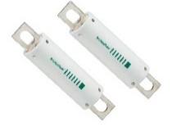
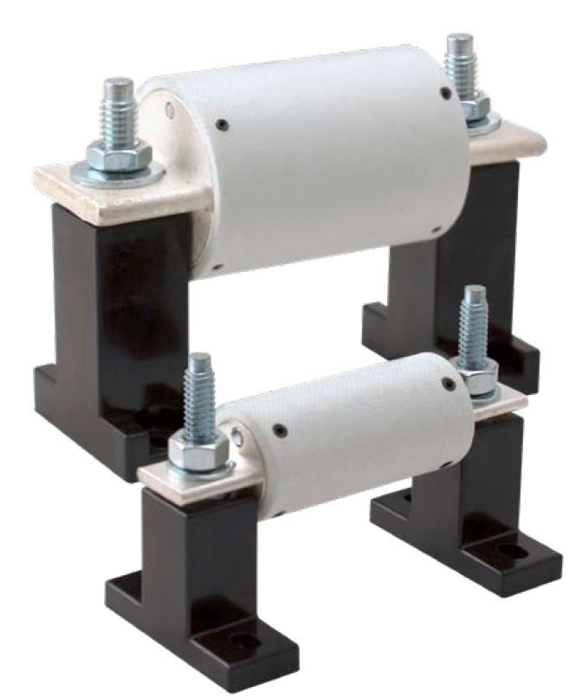



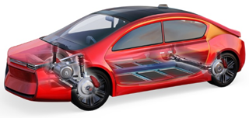
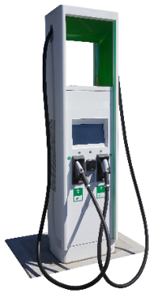
EV1K Series Fuse
1000 VDC/60–125 A Auto Grade
Problem/Solution
The EV1K Series Fuse is designed specifically for automotive-grade solutions applications. It provides overcurrent protection in applications connected to Electric Vehicles' high voltage power supply. With a rating of 1000 Vdc, the fuse is currently available in amperage ratings of 60 to 125 A (ratings up to 600 A are forthcoming). It uses a bolt-down form factor with a 25 mm x 73 mm cartridge body. The certification testing for this fuse uses the ISO 8820 and LV standards to ensure it is compatible with the Automotive environment (thermal shock/cycling, vibration, etc.).
Benefits
Durable against mechanical vibration and shock,
which increases product life and longevity
High interrupt rating and open state resistance
for compatibility with short circuit protection
Resistance to thermal shock to handle
temperature fluctuations for reliable
cycling performance
Temperature and humidity-resistant to withstand
a wide variety of environmental conditions
Recommended
Fuse Blocks
LSCR001 (60–125 A)
LSCR002 (150–600 A)
Technical resources (Click on below icons to learn more)
Features
Rated for 1000 Vdc with interrupting rating of
30,000 A and 60−125 A nominal amperage ratings
in bolt-down package
End caps with integrated bolt-down terminals
Compact body size of 25x73 mm
Operating temperature range from -40 ºC to 125 ºC
Series Page
Datasheet
Tech Info
On Board Charger
Battery Distribution Unit
Markets/Applications
EV Power Circuits including:
  On-board charger
  Battery pack/distribution unit
  DC/DC converter
  Traction motor inverter
DC/DC Converter
High Voltage
Battery Pack
Ancillary Loads
Traction Motor Inverter

Slide 3
Target markets and applications
Markets | Applications | Select OEMs and Tier 1 Suppliers | Geography
Electric and Hybrid Passenger Cars | On Board Charger, DC/DC Converter, Battery Pack and Distribution Unit, Traction Motor and Ancillary Loads | General Motors, Ford, Tesla, Stellantis, Continental, Lear, LG Energy, CATL, BYD, Delta, Yazaki | Global
Commercial Vehicle (Truck, Bus, etc.) Heavy-Duty Hybrid and Electric | On Board Charger, DC/DC Converter, Battery Pack and Distribution Unit, Traction Motor and Ancillary Loads | Daimler, Mercedes-Benz, Volvo, Nikola, Tesla, Mitsubishi, Kenworth-Toyota, BYD, Proterra, Tata Motors | Global
Off-Highway (Construction, Agriculture) Hybrid and Electric Vehicles | On Board Charger, DC/DC Converter, Battery Pack and Distribution Unit, Traction Motor and Ancillary Loads | Cummins, John Deere, Caterpillar, Volvo, Komatsu, JCB, Bobcat, Hyundai, Monarch Tractor, Mahindra | Global
Electric Vehicle Infrastructure | AC Chargers and DC Chargers | ChargePoint, EV Box, BYD, Blink Charging, ABB, Eaton | Global

Slide 4

EV1K fuse for EV battery pack protection
Click on the product series in the table below for more info
4
Contractor main switch
Technology |  | Product Series
1 | SMD Fuse | 501A, 881A
 | TVS Diode | TPSMC, SZ1SMC, SZ1.5SMC
2 | SMD or In-line Fuse | 438A, 441A, 521
 | TVS Diode | TPSMB, SZ1SMB, SZP6SMB
3 | Diode Array | AQ05C
 | TVS Diode | TPSMA6L, SZ1SMA
4 | High-voltage fuse | EV1K
5 | Gate Driver | IXD_6xxSI
6 | Diode Array | AQ24CANA
 | Fuse | 885
 | TVS Diode | TPSMB, TPSMC
Pack 1
High voltage main fuse
Module
Module 2
Module n
1
Li-ion Cells
Li-ion Cell pack
Li-ion Cell pack
5
Control & protect circuit
2
Cell balancing & control
Cell balancing & control
3
Cell balancing & control
6
Output
Battery system controller
Pack X
NEW
Module 1
Module 2
Module n
1
Li-ion Cell pack
Li-ion Cell pack
Li-ion Cell pack
2
Cell balancing & control
Cell balancing & control
3
Cell balancing & control
Legend:
Power
Data
Acronyms:
MOV: metal oxide varistor
TVS: transient voltage suppressor
SMD: surface mount device

Slide 5
Battery distribution unit block diagram
Click on the product series in the table below for more info
Battery pack
 | Technology | Series
1 | Pre-Charge Contactor | DCNSEV, DCNLEV
2 | Main Positive Contactor | DCNEV
3 | Auxiliary Fuse | EV1K
4 | Auxiliary Contactor | DCNEV, DCNLEV
5 | Main Negative Contactor | DCNEV
6 | Pyro Safety Module | PSM*
1
+
Battery distribution unit
MCU
Main Pos/Fast Charger+
NEW
2
3
4
6
Inverter
Converter
PTC Heater
* Please contact Littelfuse Associates for details
A/C Compressor
Others
5
Main Neg/Fast Charger-
−

Slide 6
On-board charger block diagram
Click on the product series in the table below for more info
Technology |  | Series
I | Fuse | 10EV*, 20EV
 | MOV | AUMOV
 | GDT | CG2, CG3
 | SIDACtor | Pxxx0FNL, Pxxx0SD
II | Thyristor | S8016xA
III | Gate Driver | IXD_6xxSI, IX4340NE
IV | TVS Diode | TPSMB, SZ1SMB, SZP6SMB
V | Gate Driver | IXD_6xxSI, IX4340NE
 | TVS Diode | TPSMB, SZ1SMB, SZP6SMB
 | Diode Array | AQ4022
VI | Fuse | EV1K
 | MOV | AUMOV
 | TVS Diode | TPSMB, SZ1SMB, SZP6SMB
VII | Diode Array | AQ24CANA
Input
voltage
DC
link
Output
voltage
AC
II
V
I
III
IV
VI
P
N
Cable
OR
PE
AC
EMI
Filter
Power factor correction
Rectifier
DC/DC converter
Stationary
base
Control unit
VII
NEW
* Please contact Littelfuse Associates for details

Slide 7
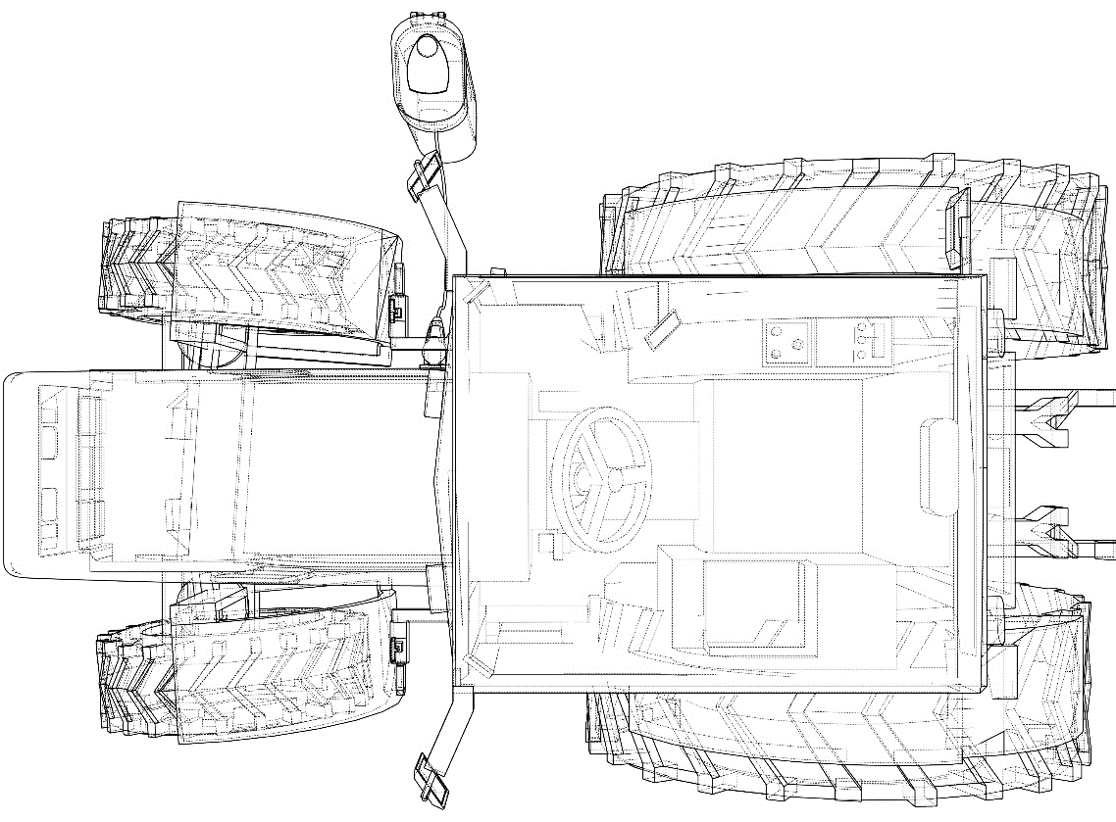
Off-highway electric vehicle powertrain architecture
Click on the product series in the table below for more info
1
 | Technology | Product series
3 | Ignition Switch | 95060
 | High-current Fuse | ZCase
 | Fuse Block | FHZ
 | TVS Diode | SLD8S
 | DC Power Distribution Module | HWB60, HWB18
 | Manual Battery Disconnect Switches | 08010100, 08099100
4 | TVS Diode Array | AQ24CANA
 | TVS Diode | TPSMB, SZ1SMB, SZP6SMB
 | Gate Driver | IXD_6xxSI, IX4340NE, IX4351NE
 | Si/SiC MOSFET | X Class, X2 Class, LSIC1MOxx
 | Diode | DSEP,LSIC2SD, DHG
5 | TVS Diode Array | AQ24CANA
 | TVS Diode | TPSMB
 | Gate Driver | IXD_6xxSI, IX4340NE, IX4351NE
 | IGBT Discrete (1200 V, 150 A) | Trench XPTTM , Planar
 | IGBT Module (1200 V, 450 A) | MIXA450PF1200TSF
6 | DC output Fuse | EV1K
 | HV DC Contactor Relays | DCNEV, DCNLEV
 | Power Distribution Module | MDB5
Charging cord
On-Board charger
12V battery
+ PDU
3
2
AC
compressor
DC/DC
converter
4
Battery pack
+ BMS
PTC
heater
Junction
box
6
Electric
PTO motor
Electric
PTO motor
5
Traction motor inverter
Drive
motor
Legend:
Low/High-voltage DC
AC input voltage
NEW
BMS: Battery Management System
PDU: Power Distribution Unit
PTO: Power Take-off
PTC: Positive Temperature Coefficient
* Please contact Littelfuse Associates for details

Slide 8
DC Charger cabinet level protection
Click on the product series in the table below for more info
AC
DC
 | Technology | Series
1 | Fuse x 3 | PSR, L50QS, L75QS
2 | Ground Fault Relay | SE-704, SE-CS30
3 | AC Contactor | HCD
4 | AC Relay | SC0x*
5 | Fuse + Fuseholder | LVSP + LPSM
6 | Surge Protection Device | SPD Type 2
7 | DC Contactor Relay | DCNxx
8 | Fuse x 2 | SFPJ, PSR, EV1K
Power converter
CCS
Tº
Main isolator
7
8
AC main
1
2
3
Power converter
2
1
RCD high immunity
CHAdeMO
Tº
4
3
6
5
Power converter
8
7
Power converter
Isolation monitoring
Isolation monitoring
NEW
Control pilot proxy
* Please contact Littelfuse Associates for details
Control
24 V Aux PSU
4
Heater
Temperature sensing
5
Communication interface
(PLC, 5G, Zigbee,
RS-485, Ethernet)
Acronyms:
RCD: Residual Current Device
CCS: Constant Current Source
PLC: Programmable Logic Controller
CHAdeMO: DC charging protocol currently enabling EV charging with power from 6 kW to 400 kW with 900 kW in preparation
6

Slide 9
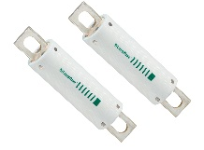
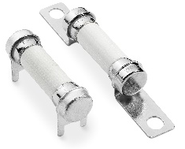
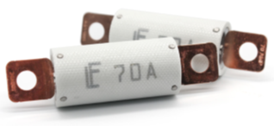

Comparison of EV1K Series with existing Littelfuse products
Parameter | EV1K | 20EV | 828
Product Photo
Footprint/Height | 73 x Φ 25 mm | 42 x Φ 20 mm | 38 x Φ 10 mm
Voltage Rating | 1000 VDC | 500 VDC | 1000 VDC
Interrupting Rating | 30 kA @ 1000 VDC | 16 kA @ 500 VDC | 10 kA @ 1000 VDC
Amperage Rating | 60 A to 125 A (under development up to 600 A) | 60 A to 125 A | 15 A ~ 30 A
Operating Temperature | -40 °C to +125 °C | -40 °C to +125 °C | -55 °C to +125 °C
Agency Approval | ISO8820, JASO D622 | ISO8820, JASO D622
Key advantages over the existing product series
Rated for 1000 VDC with interrupting rating of 30,000 A and 60−125 A nominal amperage ratings in bolt-down package
Compact body size of 25x73 mm
Operating temperature range from -40 ºC to 125 ºC

Slide 10

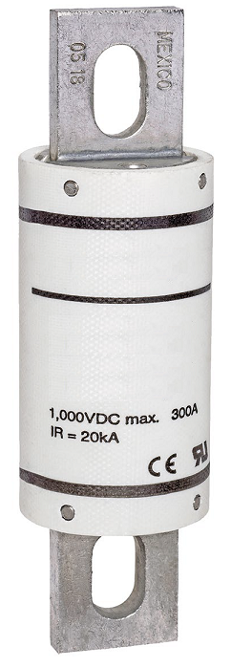
Comparison of EV1K series with competition
Parameter | EV1K | Mxx MEV100 Series
Product Photo
Voltage Rating | 1000 VDC | 1000 VDC
Interrupting Rating | 30 kA @ 1000 VDC | 20 kA @ 1000 VDC
Amperage Rating | 60 A to 600 A (currently available only up to 125 A) | 50 A to 600 A
Operating Temperature | -40 °C to +125 °C | -40 °C to +125 °C
Agency Approval | ISO8820 JASO D622 | ISO8820 JASO D622

Slide 11
Pricing, samples, availability and contacts
Pricing and samples
Please contact Littelfuse product management and sales representatives for pricing and samples availability.
Product availability
Production lead-time | 16 weeks
Packaging | Tray
Contact details
Product Manager | Ben Zheng | bzheng@littelfuse.com
Asst. Product Manager | Sakthidharan Krishnamoorthy | SKrishnamoorthy@littelfuse.com
Product Engineer | Ray Zumbahlen | RZumbahlen@littelfuse.com

Slide 12
Sales tools, technical support and keywords
Current datasheets are available on www.littelfuse.com.
Enter EV1K in the search box.
Application and Technical Support: 1-800-999-9445
Suggested Keywords
  Overcurrent Protection
  Electric Vehicles
  Electric Vehicle Infrastructure
  On Board Charger
  Traction Motor Inverter
  High Voltage Battery Pack
  Battery Disconnect Unit
  DC/DC Converter
  Off Highway Vehicles
  High Voltage Automotive Fuse
  xEV Fuse
  EV Fuse
  Electric Vehicle Fuse

Slide 13


Local resources supporting our global customers
Mount Prospect
Madison
Chicago
Troy
Champaign
Rock Falls
Bremen
Lampertheim
Essen
Lauf
Amsterdam
Deventer
Beijing
Wuxi
Suzhou
Shanghai
Kunshan
Burlington
Saskatoon
Kaunas
Chippenham
Legnago
Rapid City
Tsukuba
Tokyo
Beverly
Dongguan
Shenzhen
Hong Kong
Fremont
Milpitas
Long Beach
San Sebastian
SeongnamSeoul
Round Rock
Charneca de Caparica
Taipei
Chu-pei
Piedras Negras
Matamoros
Muzquiz
New Delhi
Taguig
Lipa City
Singapore
Manaus
São Paulo
Legend
Sales
R&D
Manufacturing

Slide 14

Partner for tomorrow’s electronic systems
BROAD
PRODUCT PORTFOLIO
COMPLIANCE AND
REGULATORY EXPERTISE
An industrial technology manufacturing company empowering a sustainable, connected, and safer world
To help customers in the design process to account for requirements set by global regulatory authorities
APPLICATION
EXPERTISE
TESTING
CAPABILITIES
Our engineers partner directly with customers to help speed up product design and meet their unique needs
To help customers get products to market faster, we offer certification testing to global regulatory standards
GLOBAL
CUSTOMER SERVICE
GLOBAL
MANUFACTURING
Our global customer service team is with you to anticipate your needs and ensure a seamless experience
High-volume manufacturing that is committed to the highest quality standards

Slide 15


Littelfuse.com
This document is provided by Littelfuse, Inc. (“Littelfuse”) for informational and guideline purposes only. Littelfuse assumes no liability for errors or omissions in this document or for any of the information contained herein. Information is provided on an “as is” and “with all faults” basis for evaluation purposes only. Applications described are for illustrative purposes only and Littelfuse makes no representation that such applications will be suitable for the customer’s specific use without further testing or modification. Littelfuse expressly disclaims all warranties, whether express, implied or statutory, including but not limited to the implied warranties of merchantability and fitness for a particular purpose, and non-infringement. It is the customer’s sole responsibility to determine suitability for a particular system or use based on their own performance criteria, conditions, specific application, compatibility with other components, and environmental conditions. Customers must independently provide appropriate design and operating safeguards to minimize any risks associated with their applications and products. Read complete Disclaimer Notice at: www.littelfuse.com/disclaimer-electronics.

