Slide 1
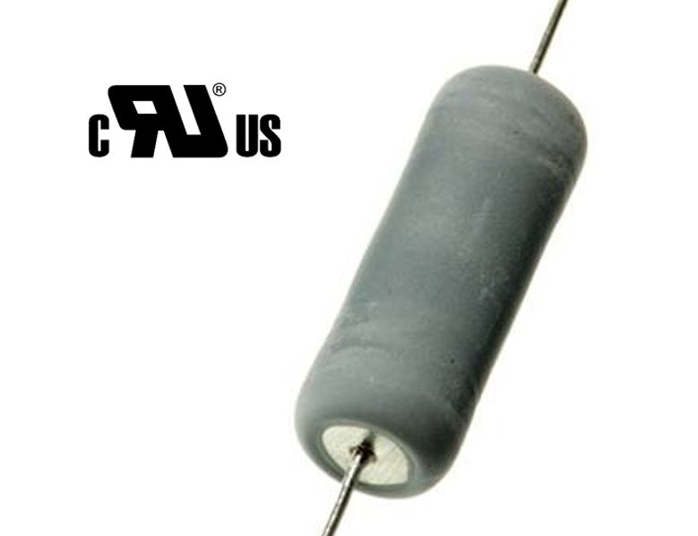
WHS-UL – Wirewound High Surge UL Recognised Fusible Resistors
Surge tolerant – Inrush limiting – Safety fusing function
WHS-UL is a flameproof wirewound resistor which combines high surge tolerance with failsafe line voltage fusing. Aimed at inrush control applications, the resistor is available in three body sizes rated at 2, 3 and 5W. The most common decade of values for this application, 10 to 100 ohms, is covered by E24 standard values.
Enhanced surge & pulse energy capacity
UL1412 recognised fusible resistor (UL file E234469)
Failsafe fusing at 120 / 240Vrms
UL94-V0 flameproof coating
Leadform options including surface mountable
High surge energy density permits greater product reliability with less PCB area being consumed.
A resistor with UL1412 recognised fusibility enhances product safety and simplifies UL approval.
The provision of full surge and fusing data supports rapid achievement of EMC and safety testing goals.
Power supply
White goods
UPS
Energy meter
Motor drive

